Slide 1
Parallel Chess AI
Ishaq Yousef Haj Hasan Sameer Ahmad

Slide 2
Project Overview
It is evident that the realm of artificial intelligence had received major breakthroughs through the means of chess programming. Chess Programming has been a historical means to assess the capabilities and functionalities of hardware components of a computer. In addition to this, there are countless different avenues that can be explored when examining the possibilities for incorporating advanced search and evaluation heuristics that fundamentally challenge the software capabilities that it is linked to. Due to this very reason, we chose to base our final project around parallelizing chess implementations. We will focus briefly on the foundations of a chess implementation and will delve into various parallelizing approaches that we used to achieve significant speedups in the various modules of our chess implementation.

Slide 3
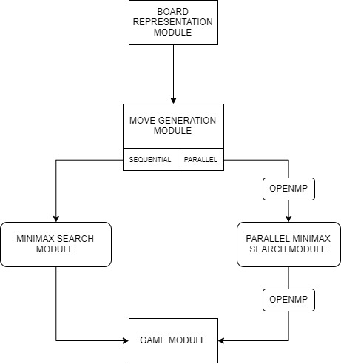
Algorithm Design
Our Implementation can be represented with five distinct modules:
BOARD REPRESENTATION
MOVE GENERATION
MINIMAX SEARCH
PARALLEL MINIMAX SEARCH
GAME

Slide 4
Parallelism:= OpenMP
WHY OPENMP: The reason for using the OpenMP API over other various APIs we have been exposed to over the course of our parallel class is due to that fact that OpenMP directives very explicitly offer the use of dynamic scheduling within tasks that is much more efficient in handling parallelism when it comes to distributing work load induced by search space traversal and move generation.
Observations: Speed-Ups observed were greater for partial boards with a smaller set of next possible legal moves (about 20x that of the sequential implementation).

Slide 5
Contd…
#pragma omp for
We use the OpenMP pragma directives to incorporate parallelism into regions of code with high parallelizability. These include for loops to sweep board for potentially movable pieces and recursion under minimax search traversal
schedule(dynamic)
Since spawning multiple threads over a for loop didn’t guarantee that workload distributes evenly, we explicitly indicated our scheduling to be dynamic using the schedule(…) directive for gen_all_next_moves()

Slide 6
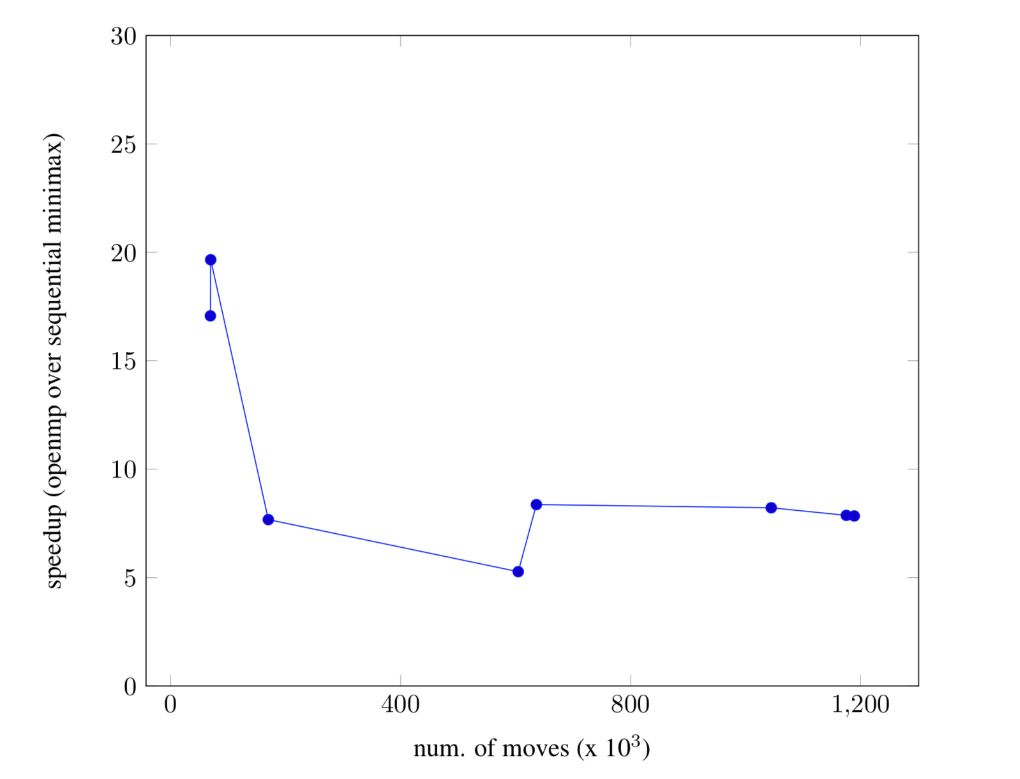
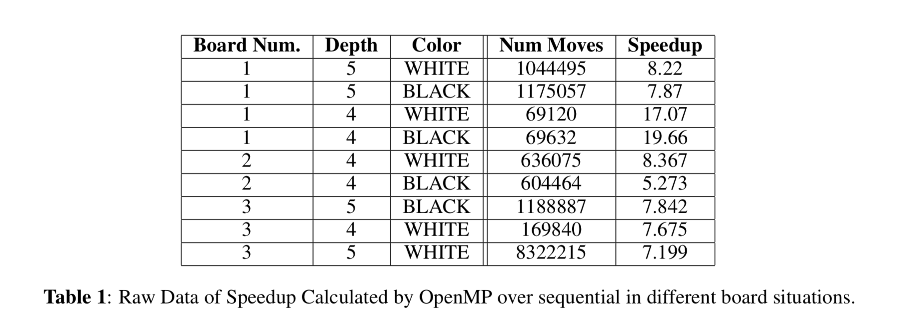
Results (OpenMP)

